Slide 1


SMART ORGAN DONATION AND TRANSPLANT SYSTEM
KOLHAPUR INSTITUTE OF TECHNOLOGY'S COLLEGE OF ENGINEERING, KOLHAPUR.
DEPARTMENT of CSE(AIML)
Presented by: A54-Sanika Shinde
A64-Vaishnavi Benake
A45-Sakshi Patil
A71-Purva Marve
Under guidance of: Mr. Avinash Bhudargade
Mr. Nikhil Bhosale
Mrs. Ujjwala Salunkhe

Slide 2

Introduction: Revolutionizing Organ Donation
Organ donation is a life-saving procedure that requires timely and accurate donor-recipient matching.
Current systems face delays due to manual coordination and lack of transparency.
Many patients die while waiting for compatible donors due to poor communication between hospitals and registries.
Technology can play a key role in streamlining the organ donation and transplantation process.
A smart, automated system can enhance efficiency, transparency, and fairness in organ

Slide 3
Literature Review
Our research into existing solutions revealed a variety of approaches, each with unique strengths and limitations, guiding our system's design.
Author(s)
Tools / Model Used
Limitations Identified
Sharma et al. (2021)
AI-based Matching Algorithm
Lacked real-time data updates and integration with national health records.
Gupta & Verma (2020)
Centralized Organ Registry System
Risk of data manipulation and single point of failure.
Alzahrani et al. (2022)
Blockchain-based Health Record Sharing
High computational cost and limited scalability in public health settings.
Mehta & Kumar (2019)
Rule-Based Matchmaking System
Inflexible with complex donor-recipient compatibility factors.
WHO Report on Organ Donation (2020)
Policy-Level Coordination Tools
Not technology-driven; lacks automation and smart prioritization mechanisms.

Slide 4

Limitations of Existing Systems
Manual matching leads to delays and human error.
No real-time notifications or updates.
Poor integration across hospitals and transplant centers.
Inadequate prioritization for emergency cases.
Limited public awareness and voluntary donor registration.
Lack of transparency and accountability.

Slide 5





Problem Statement & Objectives
Problem Statement: The current organ donation and transplant systems are slow, fragmented, and inefficient, leading to preventable loss of life due to mismatches or delays.
Automated Platform
Fast & Accurate Matching
Secure Transparency
Design a smart, automated organ donation platform.
Ensure fast and accurate donor-recipient matching.
Improve transparency with secure data access.
Real-time Alerts
Boost Donor Registration
Enable real-time notifications and emergency prioritization.
Encourage more people to register as donors via digital access.

Slide 6
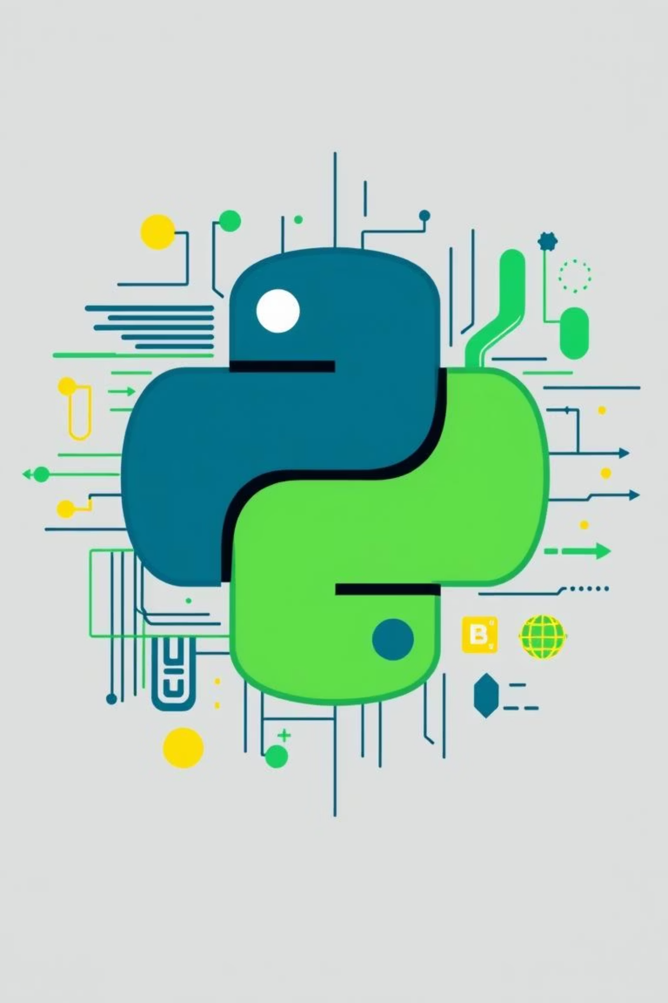
Tools and Technologies
Programming Language: Python
Libraries (Python): Pandas, NumPy, Scikit-learn, TensorFlow
Core development for backend logic and AI models.
Data analysis, preprocessing, and AI/ML modeling for optimal matches.
Database: SQLite / MySQL / PostgreSQL
Frameworks: Flask / Django
Secure storage for donor-recipient and medical data.
Backend web development for RESTful APIs and admin dashboards.
Data Structures: Lists, Dictionaries, Queues, Trees
Frontend (Optional): HTML, CSS, JavaScript (with Flask)
Efficient handling for matching algorithms and searches.
Building a user-friendly web interface for hospitals and users.

Slide 7
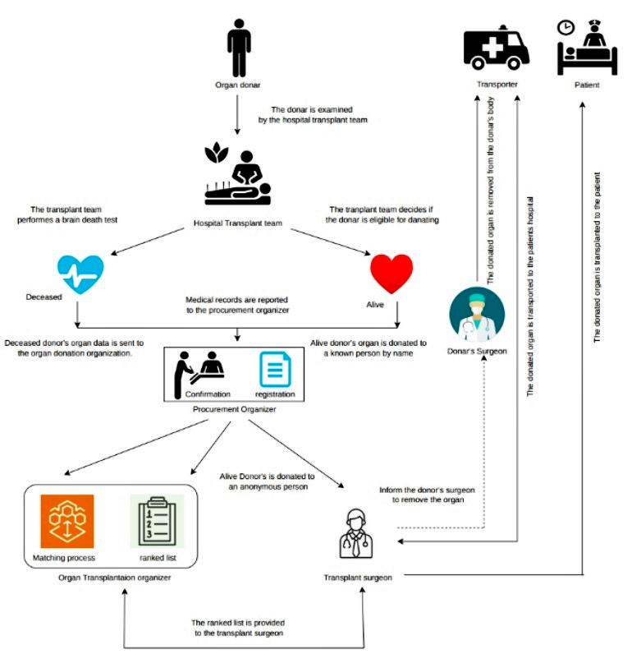
System Architecture

Slide 8
References
WHO – Global Observatory on Donation and Transplantation ( www.transplant-observatory.org)
“A Review on Blockchain Applications in Healthcare” – IEEE, 2021
National Organ and Tissue Transplant Organization (NOTTO), India
“AI in Organ Transplant Matching” – SpringerLink, 2020
Ministry of Health and Family Welfare, Govt. of India
Research papers and journals used for literature review

